Slide 1


<Your App Name>
<Description of your app>
<Your Name>

Slide 5

App purpose:
I like this app because . . .
App purpose:
I like this app because . . .
App purpose:
I like this app because . . .
App purpose:
I like this app because . . .
App purpose:
I like this app because . . .

Slide 6
Add your ideas.

Slide 7
App name:
Write a description of what the app does.

Slide 8


Slide 10


Slide 11
My app will . . .
because . . .
My app will . . .
because . . .
My app will . . .
because . . .

Slide 12
Apple Developer website

Slide 13
Human Interface Guidelines

Slide 21
Deeper Dive: The V in MVC
Model View Controllers (MVCs) are design patterns that organize an app’s files, structures, and classes. Learn more in Unit 4, lesson 3.
Now that you’ve decided on the features, you need to think through exactly how, when, and where your app will use these features and how you can use code to achieve it. It’s important not to get bogged down in the details of data modeling or how many controllers you’ll need for a particular feature. For now, keep it simple: Make some simple sketches on paper, focusing on key views that are important to your app.

Slide 22

Be sure to review the Human Interface Guidelines again.

Slide 24
this video
Video

Slide 27
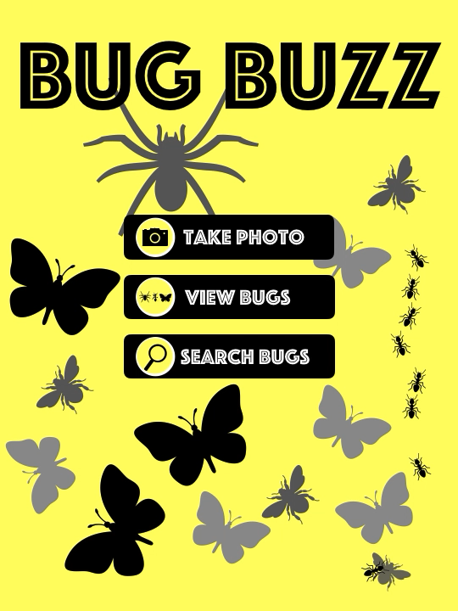
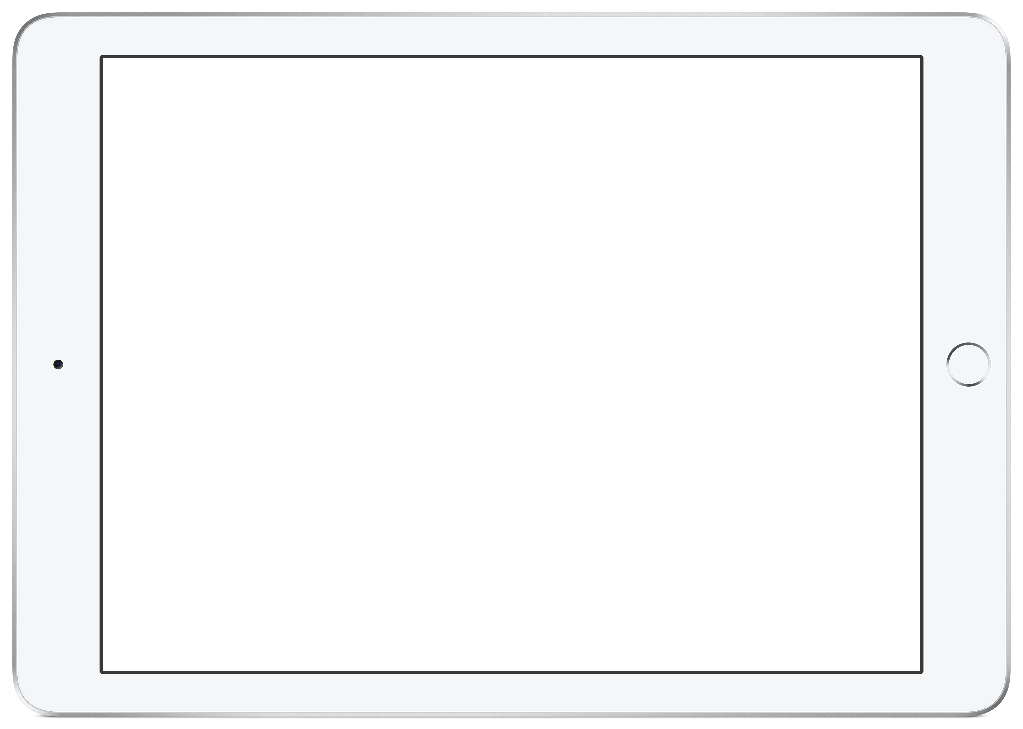
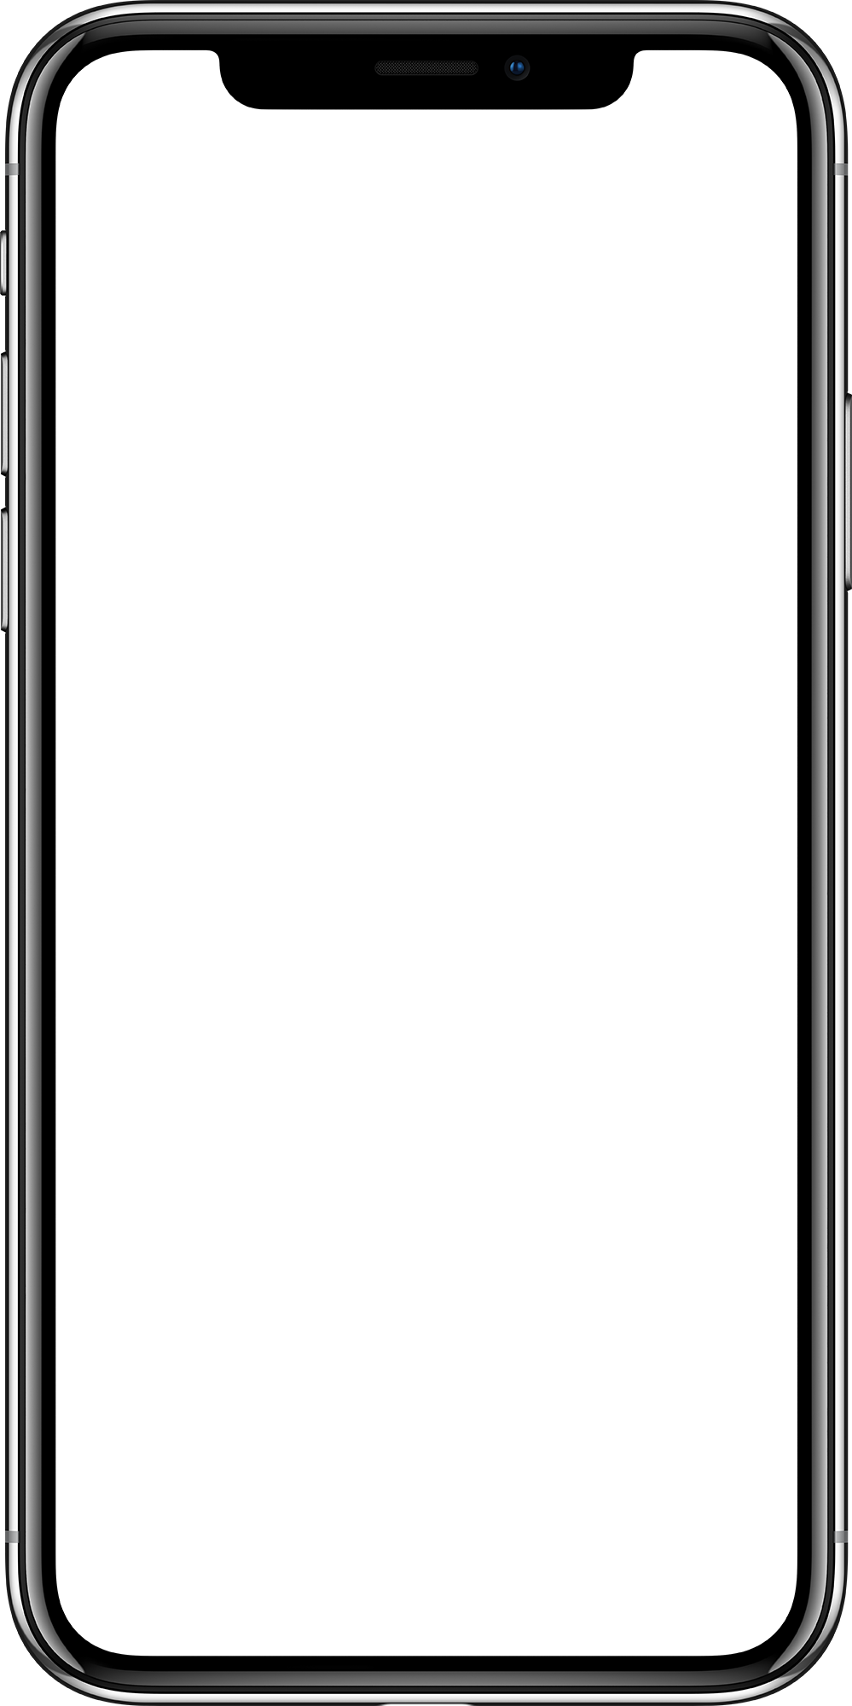

prototype
POP - Prototyping on Paper
Download
Tap or click to play the videos or download the iPad prototype and the iPhone prototype Keynote files for viewing.

Slide 28
Download

Slide 37

© 2020 Apple Inc. All rights reserved. Apple, the Apple logo, FaceTime, iPad, iPhone, Keynote, Mac, Siri, and Xcode are trademarks of Apple Inc., registered in the U.S. and other countries. App Store is a service mark of Apple Inc., registered in the U.S. and other countries. The Bluetooth® word mark and logos are registered trademarks owned by Bluetooth SIG, Inc. and any use of such marks by Apple is under license. IOS is a trademark or registered trademark of Cisco in the U.S. and other countries and is used under license. Other product and company names mentioned herein may be trademarks of their respective companies. July 2020

